Slide 1
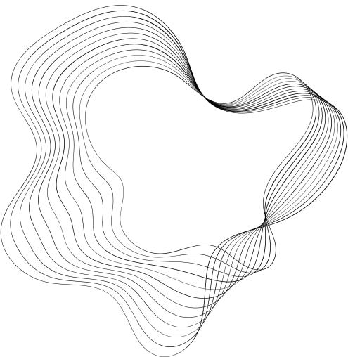

CosmI Code
WEEK-2
ABDULLAH IMRAN

Slide 2
01
“Implement a k-Nearest Neighbors (k-NN) classifier from scratch. Test the classifier on the Iris dataset.”

Slide 3

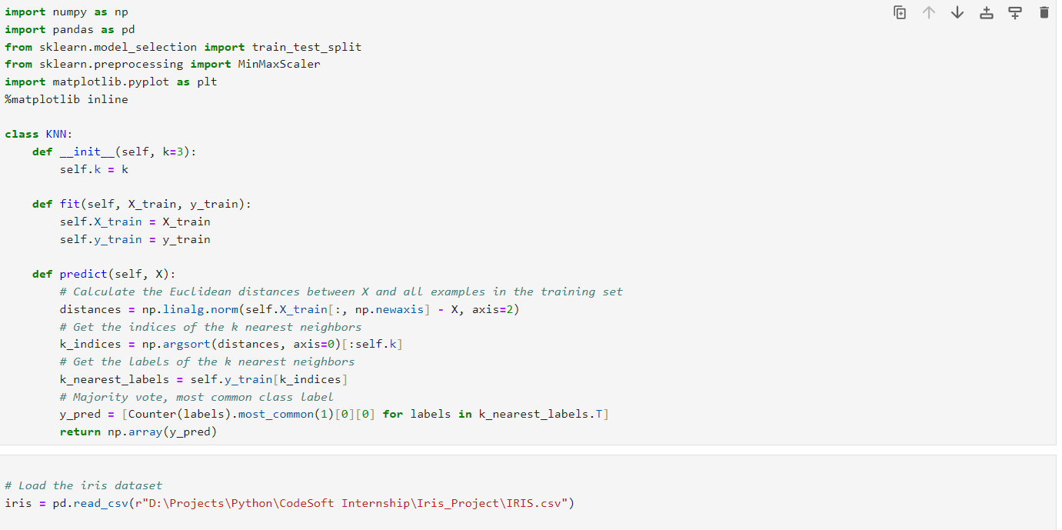
Importing Libraries & Writing Functions

Slide 4
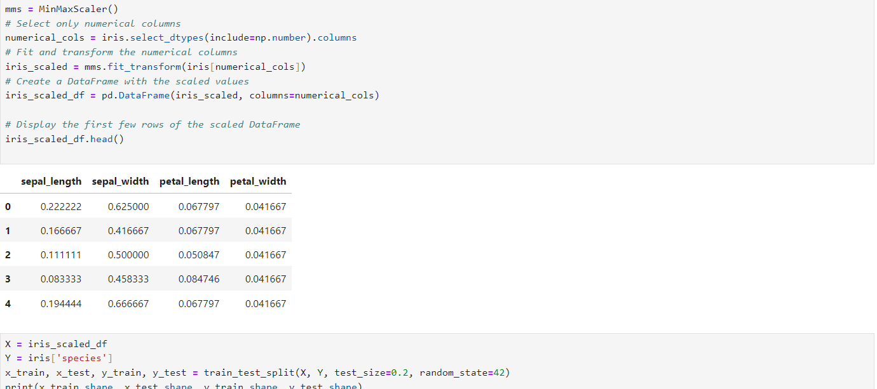
Normalizing Values & Train / Test Split

Slide 5
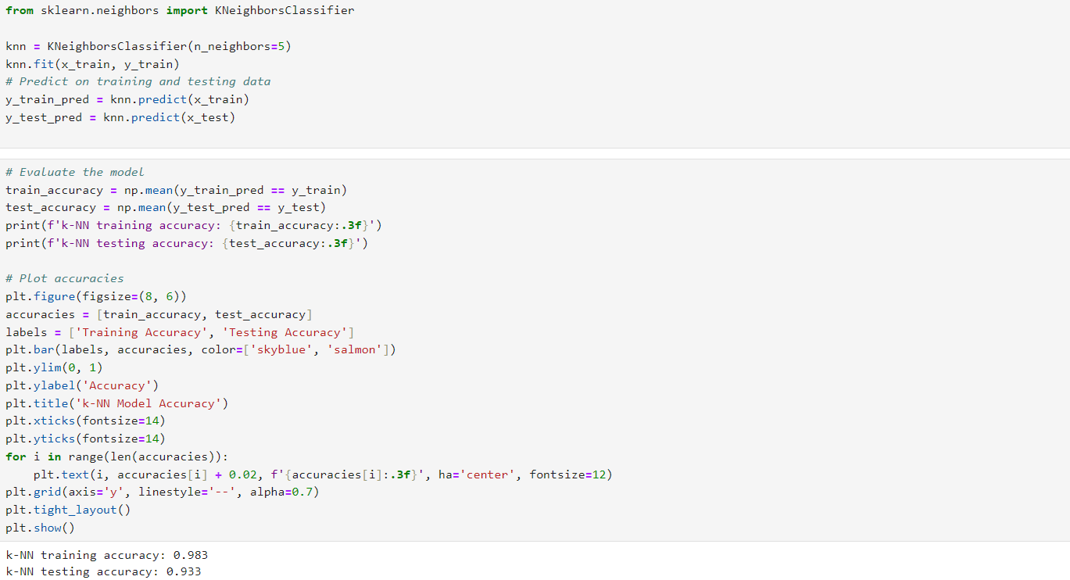
Fitting Model
Finding & Plotting Accuracies

Slide 6
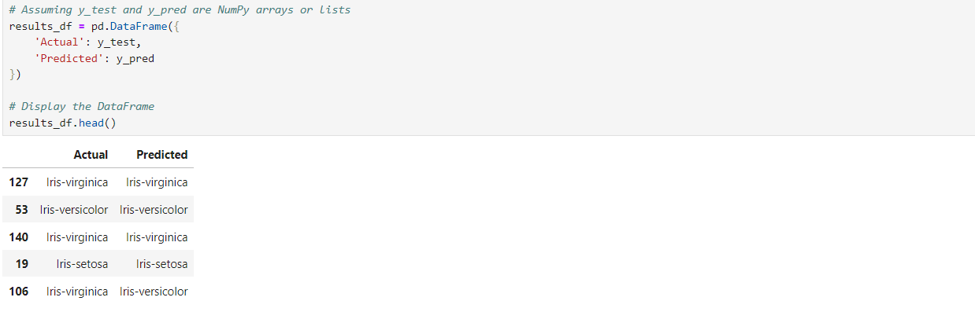
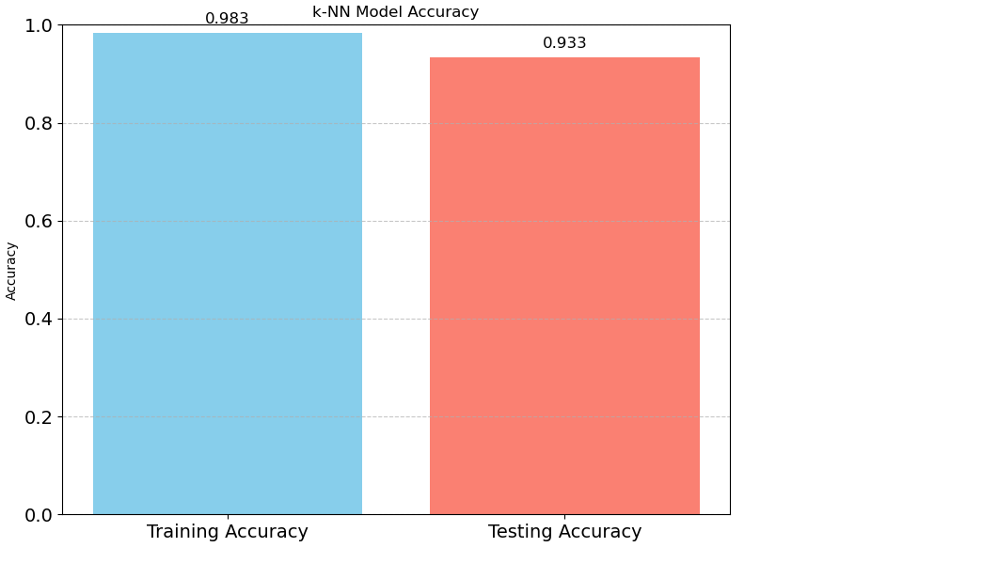

Slide 7
02
“Train and evaluate a decision tree classifier using Scikit- learn. Visualize the tree and interpret the results.”

Slide 8
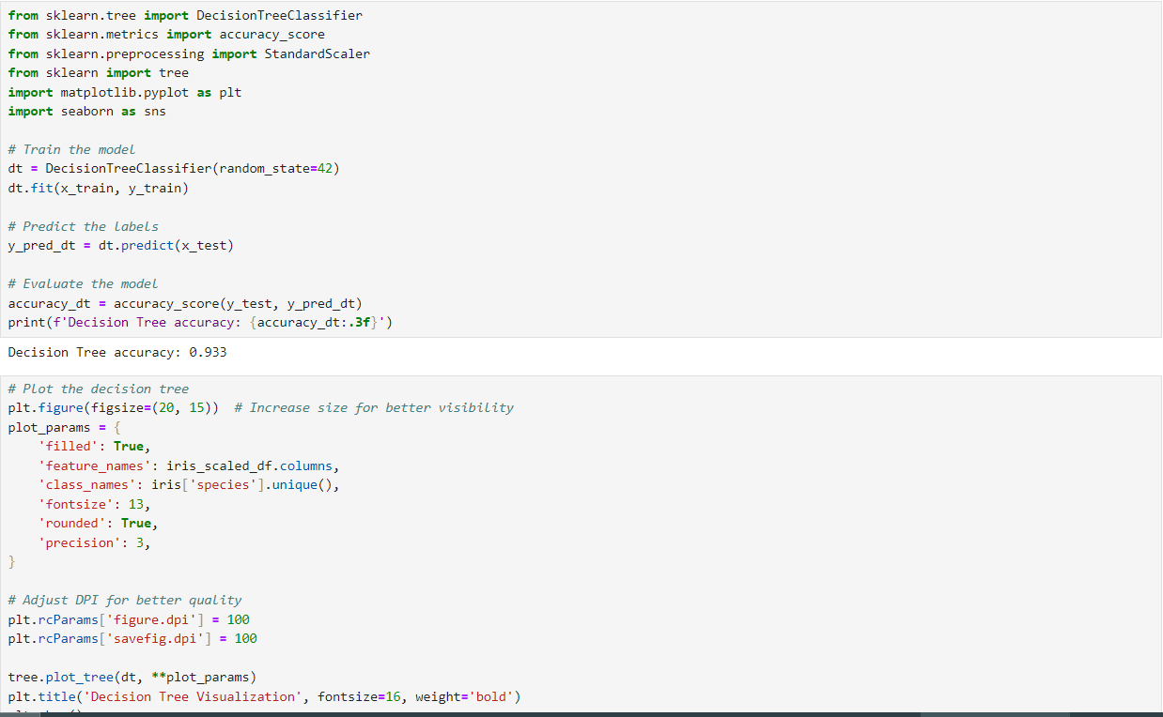
Fitting Model & Finding Accuracy
Plotting Tree
Question No.2

Slide 9
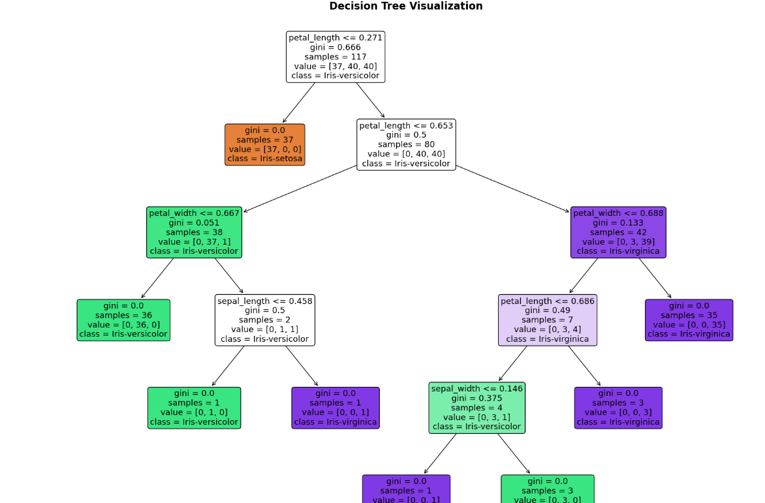

Slide 10
03
Implement a random forest classifier. Perform hyperparameter tuning using Grid Search CV to find the optimal parameters.

Slide 11
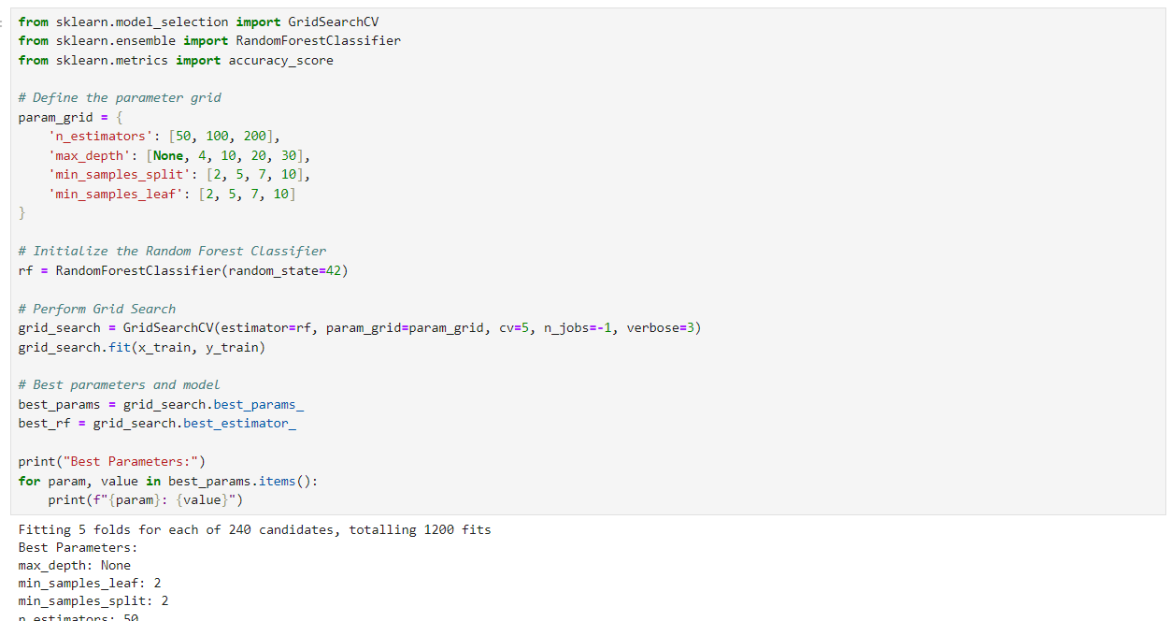
Importing Libraries & Doing Hypermeter Tuning
Fitting Best Model and Finding Accuracies

Slide 12
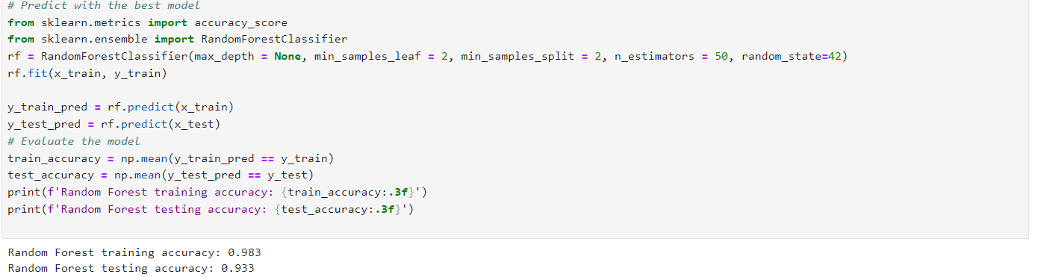
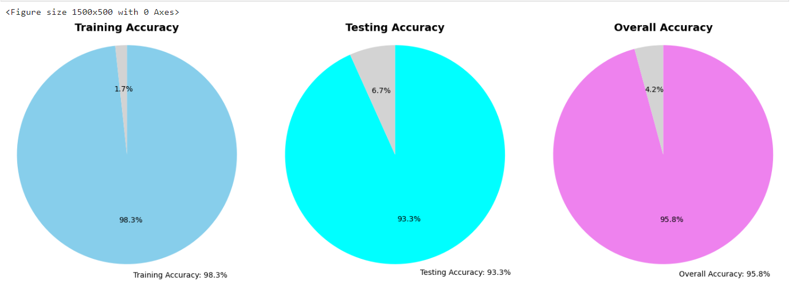
Finding Accuracies & Plotting Them

Slide 13
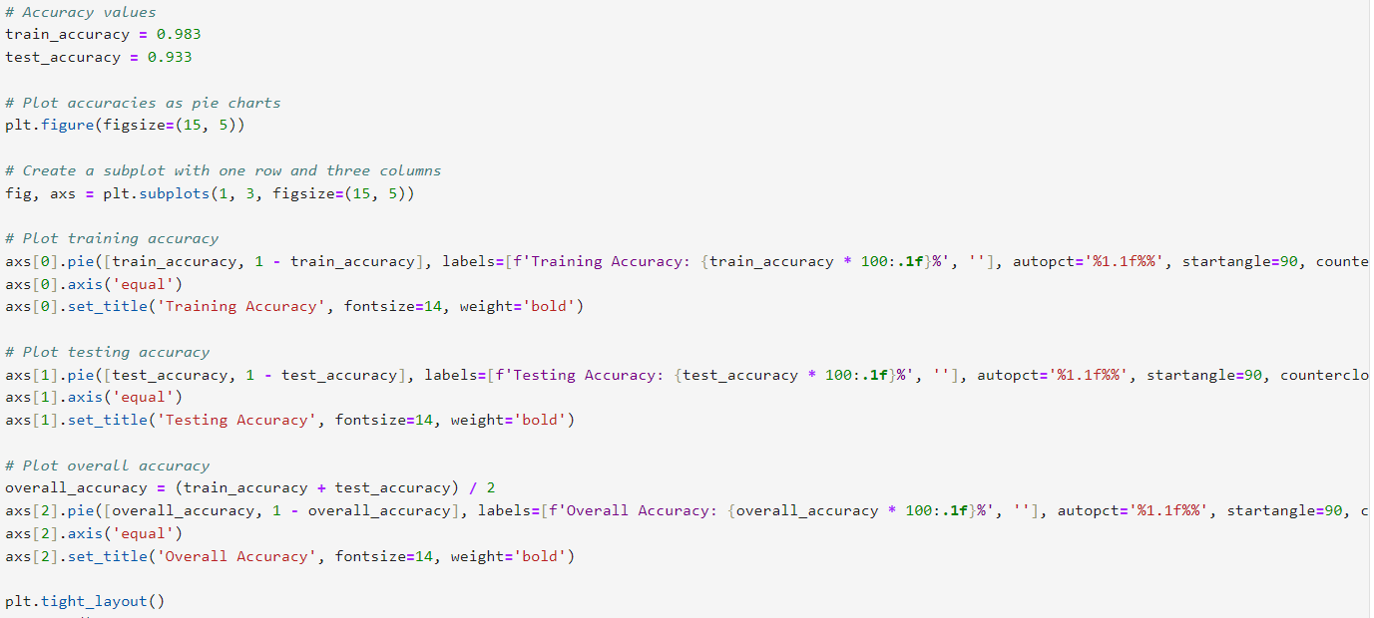
Code To Find Different Accuracies of Model

Slide 14
04
Train a Support Vector Machine (SVM) classifier on a complex dataset. Visualize the decision boundary.

Slide 15
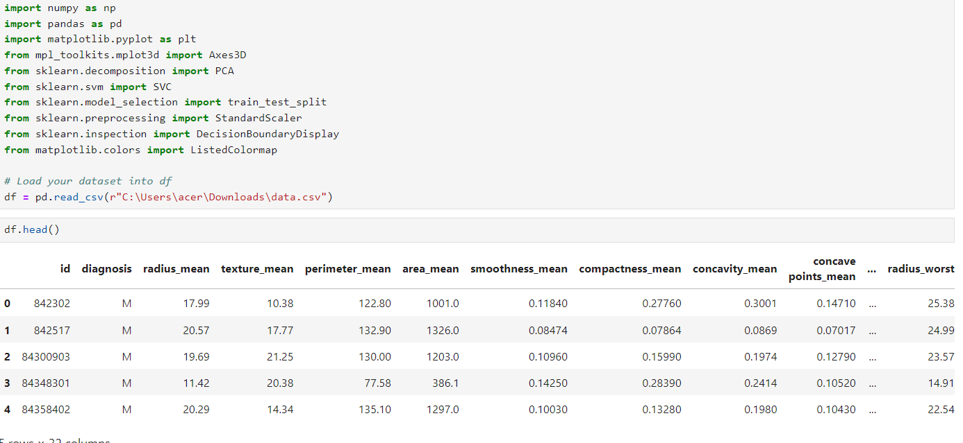
Importing Libraries & Viewing First Five Rows of Dataset

Slide 16
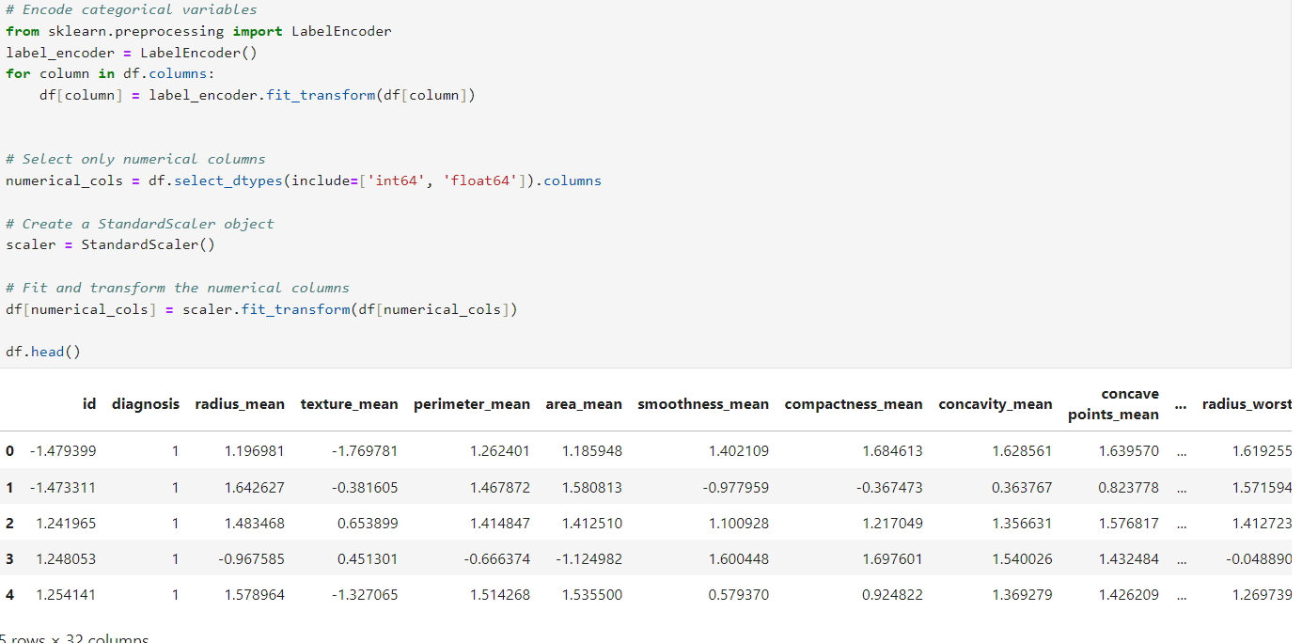
Standardizing Values & Handling Categorical Values

Slide 17
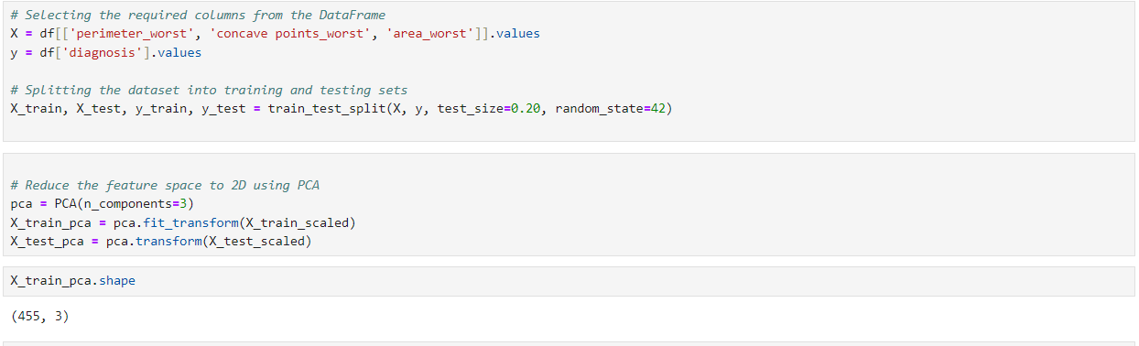
Doing Train/Test Split
Doing PCA and Checking The Shape

Slide 18
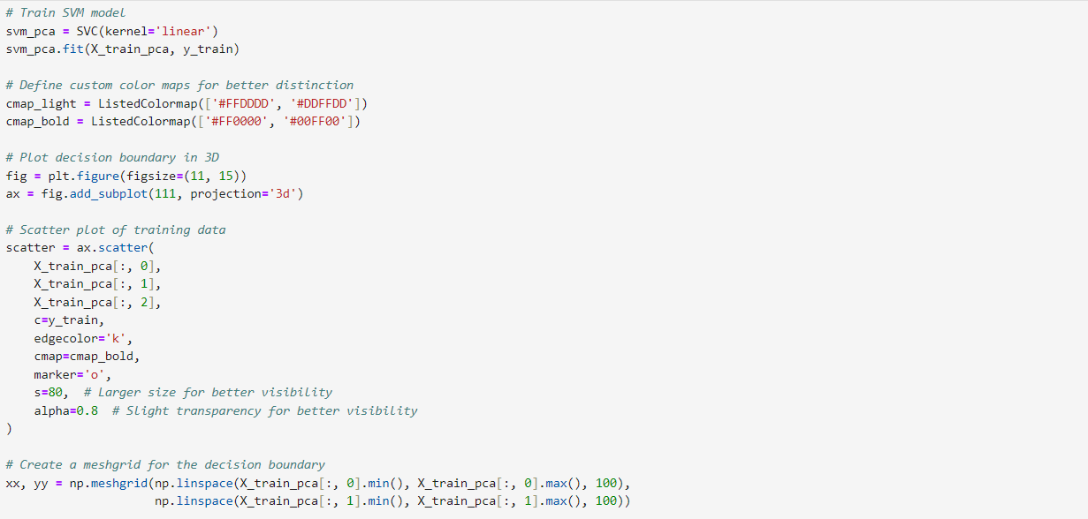
Plotting Decision Boundary With PCA

Slide 19
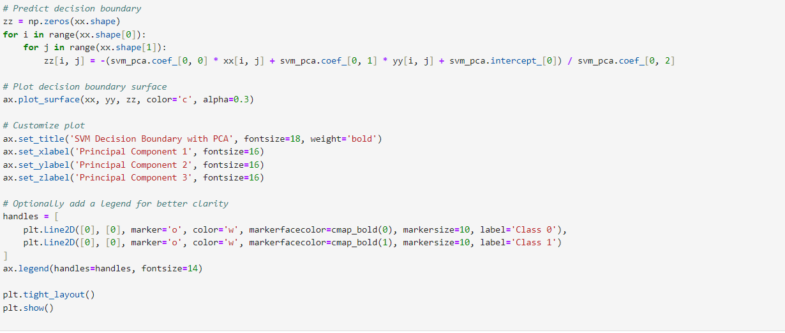

Slide 20
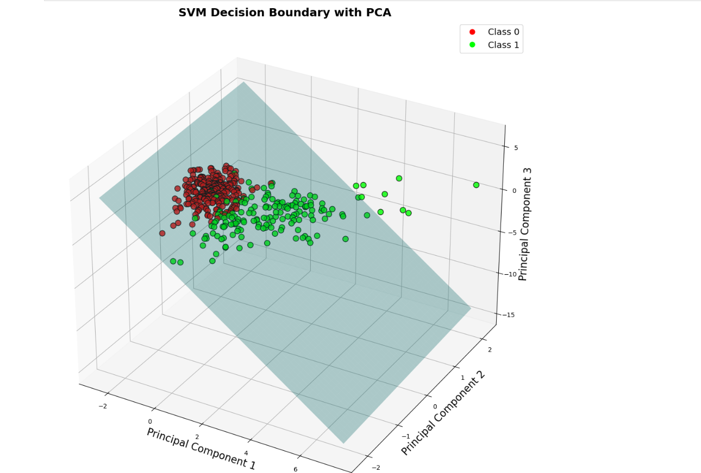

Slide 21
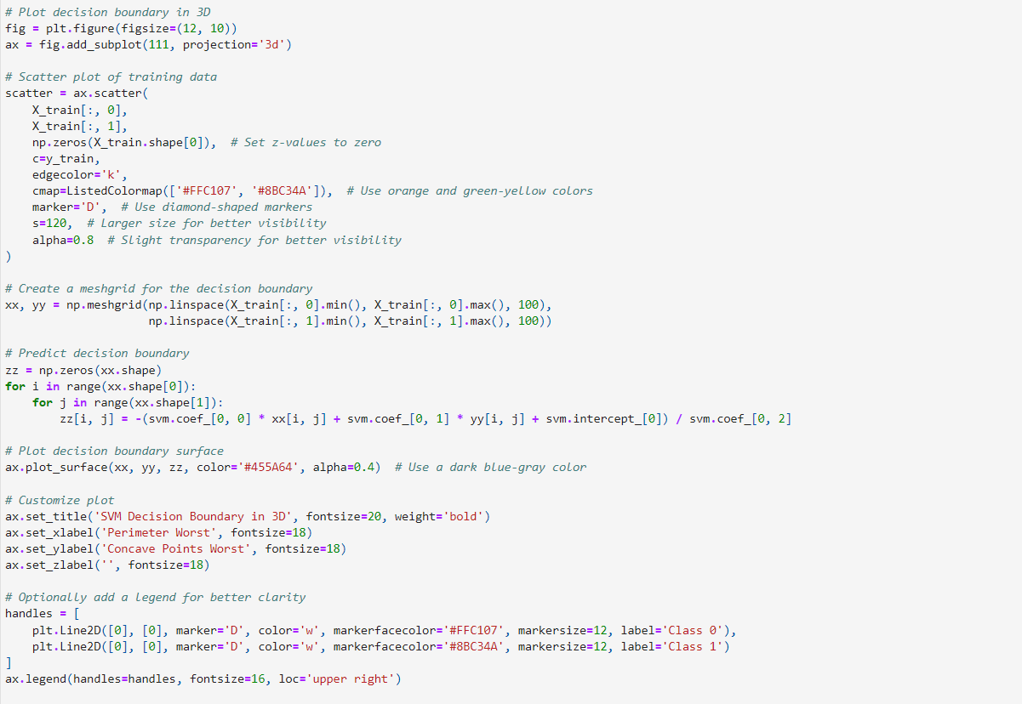
Plotting Decision Boundary Without PCA

Slide 22
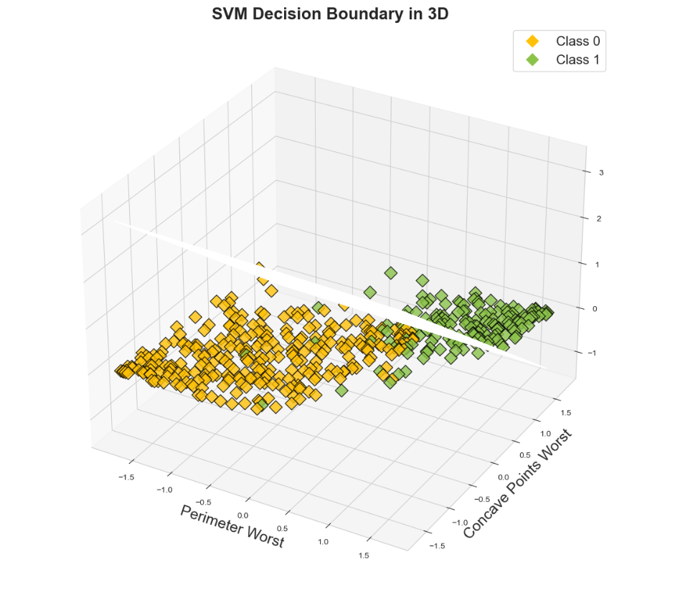

Slide 23
05
Compare the performance of different classifiers (logistic regression, SVM, random forest) on a dataset using various metrics like accuracy, precision, recall, F1-score, and ROC-AUC.

Slide 24
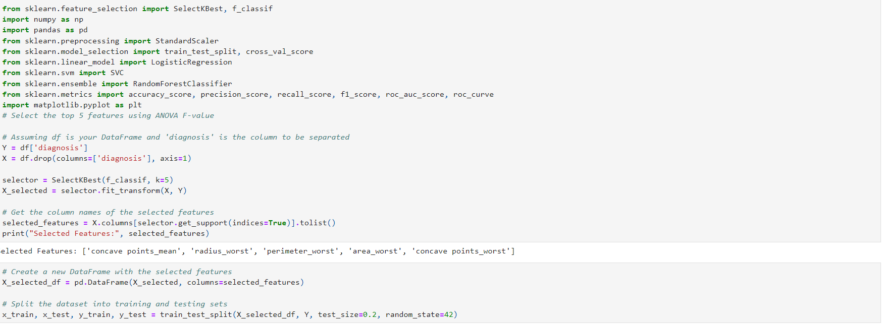
Importing Libraries
Selecting Top Features & Doing Train/Test Split

Slide 25
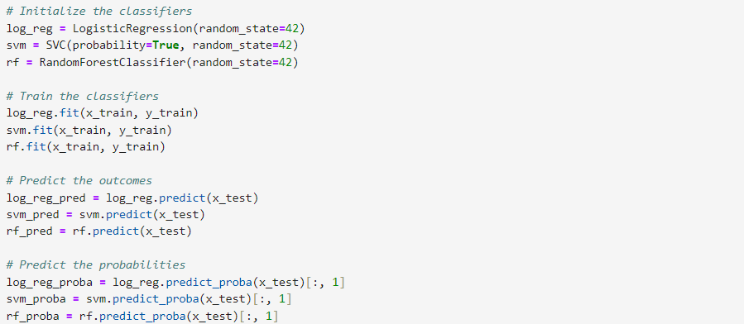
Making Models & Fitting Them
Predicting Outcomes & Probabilities

Slide 26
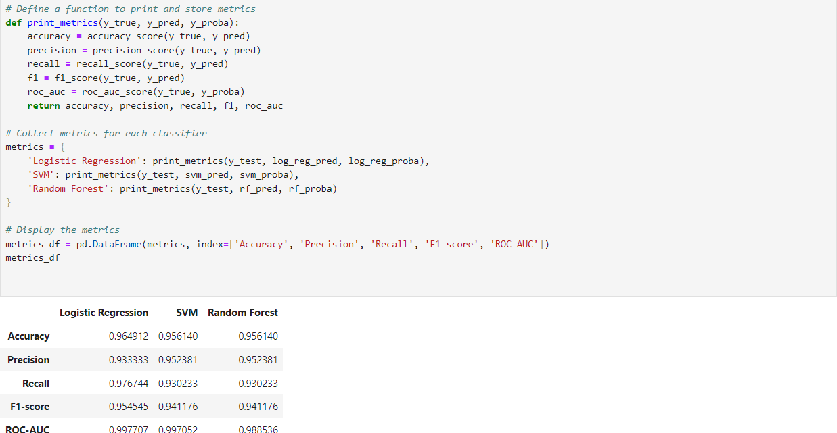
Finding & Printing Metrics For Comparison

Slide 27
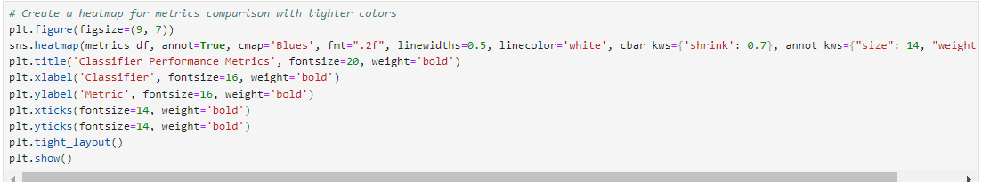
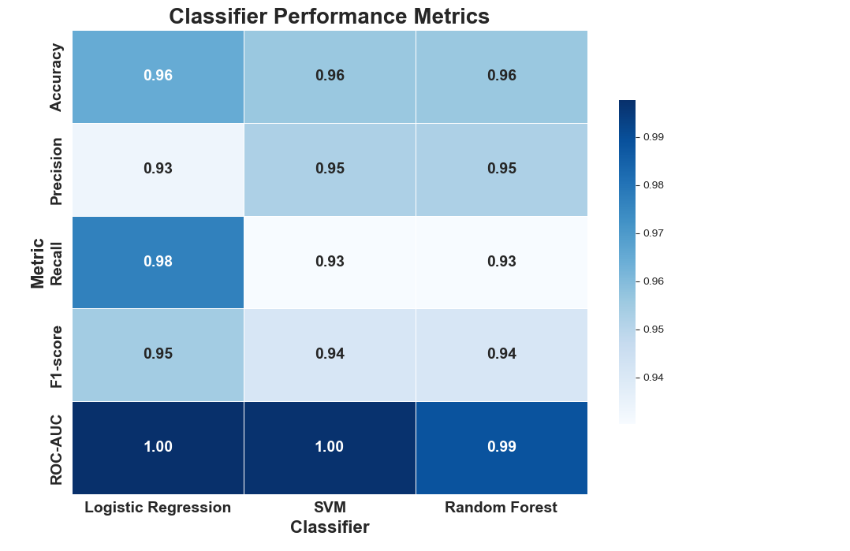
Plotting Heat-Map of Metrics Comparison

Slide 28
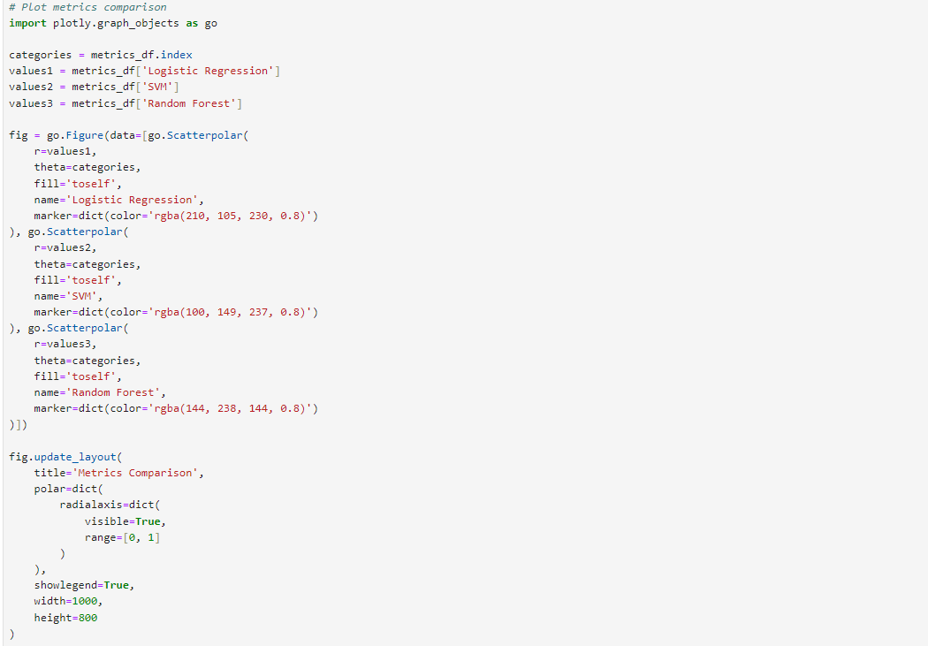
Plotting Combined Scatter Plot of Metrics Comparison

Slide 29
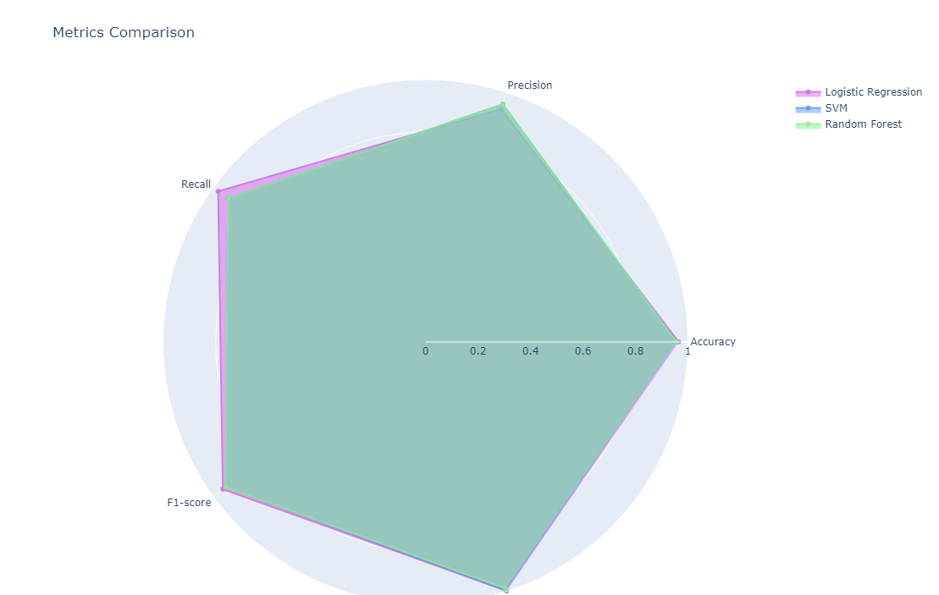

Slide 30
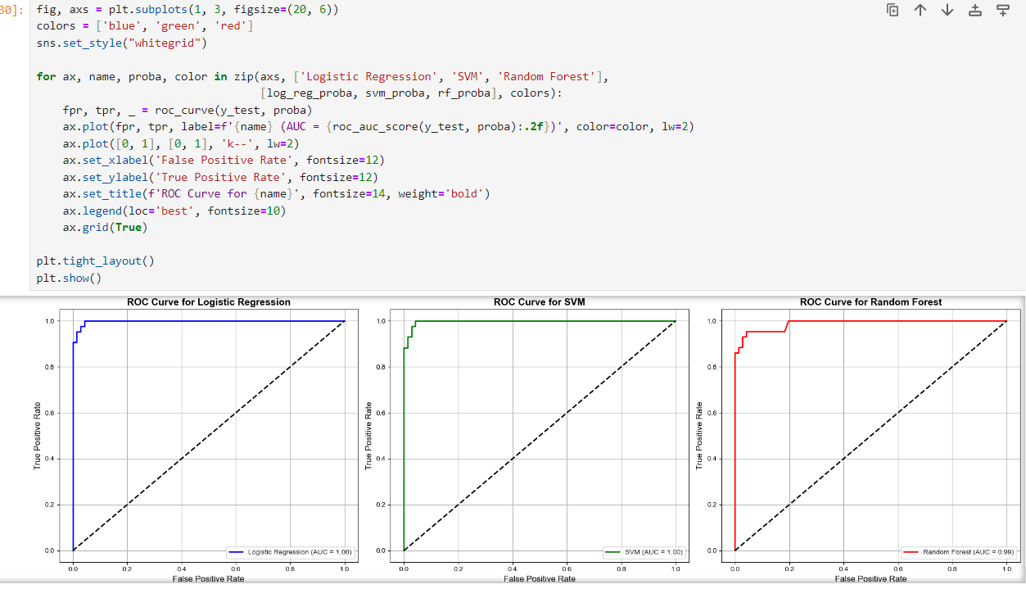
Plotting Separate ROC-Curves of Different Models

Slide 31
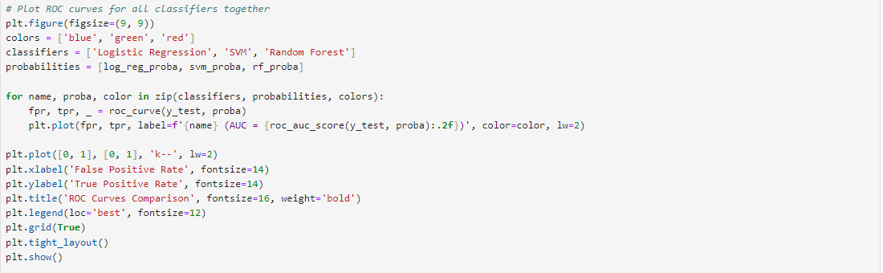
Plotting Combined ROC-Curve of All Models
Showing Difference Between ROC-Curves of Different Models

Slide 32
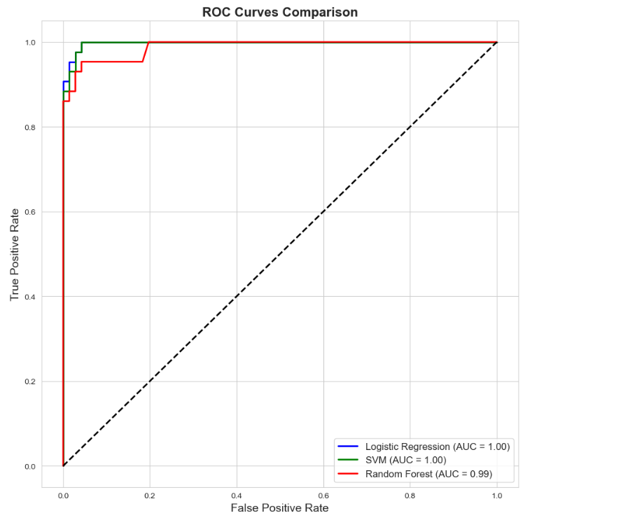

Slide 33
THANK'S FOR WATCHING
Regards,
ABDULLAH IMRAN

